Slide 1

TAIWAN SEMICONDUCTOR MANUFACTURING COMPANY LTD
NYSE:TSM
Team Members
Akanksha Telegam Setty
Kashish Naresh Santani
Kshitij Zutshi
Pramod Gopal
Rui Tang
Vishesh Gupta

Slide 2
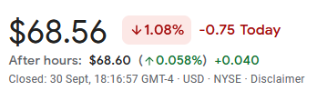
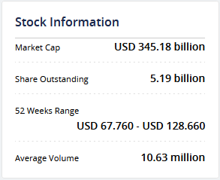
About TSM
Taiwan Semiconductor Manufacturing Co., Ltd. (NYSE -TSM) engages in the manufacture and sale of integrated circuits and wafer semiconductor devices. It was founded in 1987 as a joint venture of Philips, the government of Taiwan, and private investors
TSM is the First Taiwan Company to be listed on NYSE on October 8, 1997(9:30am New York time)
The foundry leader has an illustrious customer base, including Apple, AMD and Nvidia
📊 Stock Fact Sheet
Facts as on 01 Oct 2022 05:53 AM EST

Slide 3
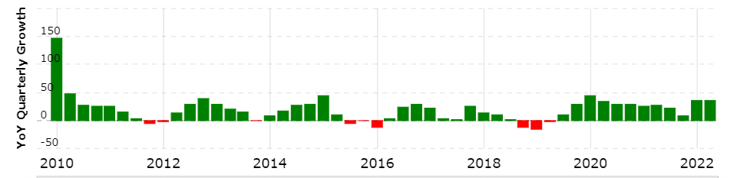
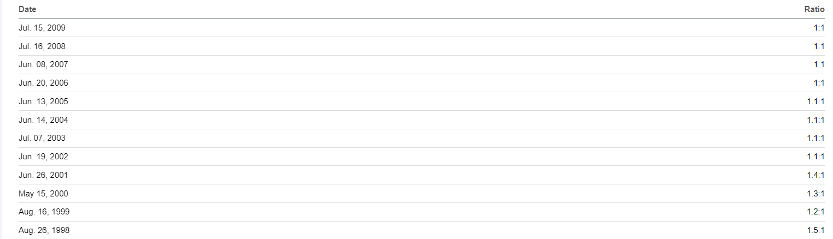
History
Since 1994, TSMC has had a compound annual growth rate (CAGR) of 17.4% in revenue and a CAGR of 16.1% in earnings.
The image below shows the Stock Split History of TSMC

Slide 4

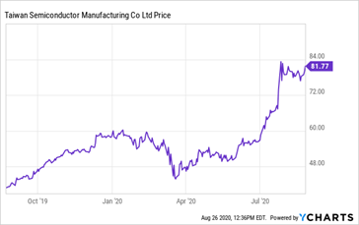
News
TSMC has acquired 1 company. It has also divested 1 asset. TSMC’s largest acquisition to date was in 2000, when it acquired WaferTech for $350M. TSMC has acquired in 1 US state. The Company’s most targeted sectors include semiconductors(100%).
The largest catalyst to TSMC’s growth during covid actually occurred in July 2020, when Intel announced that they had to delay their 7nm chip due to production problems. These consequences of Intel’s announcement caused a huge boost to TSMC’s share price, from $67 to $83 within two days of the announcement, a 62% increase.

Slide 5
Taiwan Semiconductor Manufacturing Company Ltd. (TSM) is Attracting Investor Attention: For the current quarter, TSMC is expected to post earnings of $1.67 per share, indicating a change of +54.6% from the year-ago quarter. For the current fiscal year, the consensus earnings estimate of $6.21 points to a change of +50.7% from the prior year. For the next fiscal year, the consensus earnings estimate of $6.44 indicates a change of +3.6% from what TSMC is expected to report a year ago.
When the earnings estimates for a company goes up, the fair value for its stock goes up as well. And when a stock's fair value is higher than its current market price, investors tend to buy the stock, resulting in its price moving upward.
Taiwan Semiconductor Manufacturing revenue for the quarter ending June 30, 2022 was $18.161B, a 36.33% increase year-over-year.

Slide 6

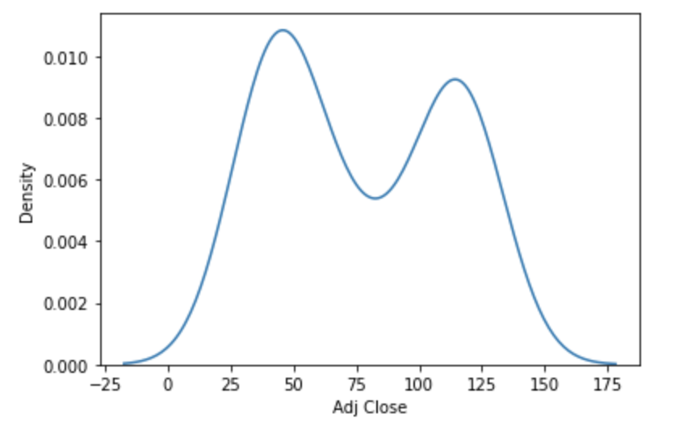
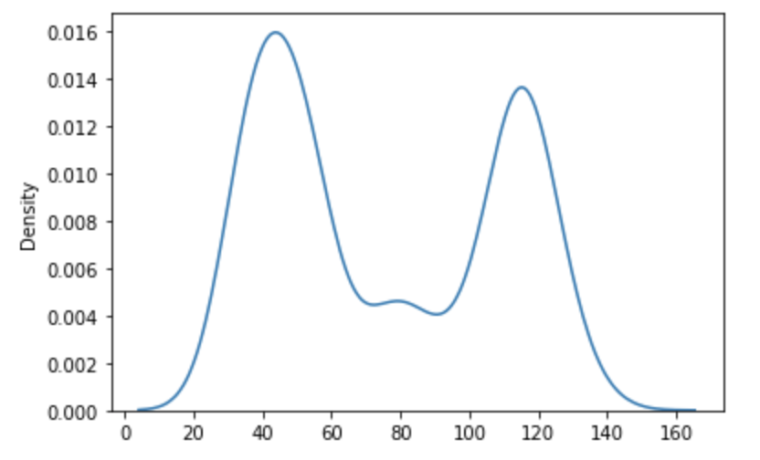
Stock Distribution
TSM stock price modelling
Timeframe - 1st January, 2019 to 4th February, 2022
After smoothing:
Distribution:

Slide 7

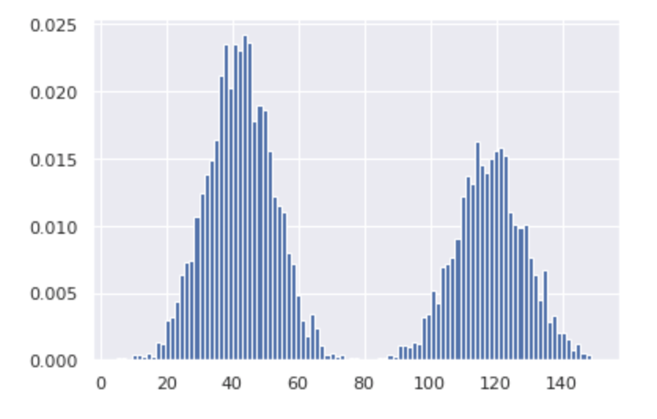
Preliminary Mixture Modelling
TSM stock price modelling
Timeframe - 1st January, 2019 to 4th February, 2022
Low peak:
Mean = 118;
Sigma1 = 121;
Range - (80, 150)
High peak:
Mean = 42;
Sigma2 = 100;
Range - (5, 80)
Estimation from mean and std deviation

Slide 8

EDA
Colab link: https://colab.research.google.com/drive/1iqgVwADIB556pZaVtyQFN1QfefdH0Rk8?usp=sharing

Slide 9
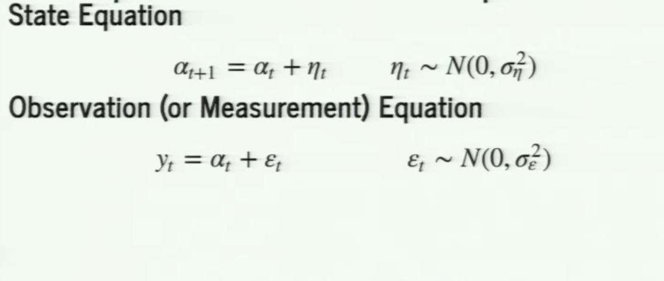
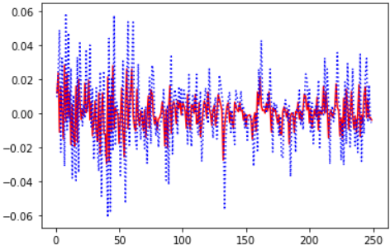
Kalman Filter
Kalman Filter model is used to forecast market prices [Parameter Estimation]
Uses time varying mean and volatility
Used to correct the noisy time-series data
The general process for a Kalman Filter model involves two steps:
Prediction step
Correction/Updation step
Colab Python FIle

Slide 10
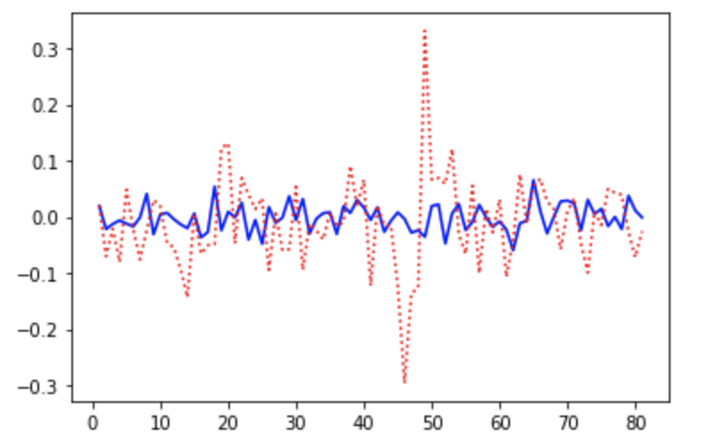
GARCH
The generalized autoregressive conditional heteroskedasticity (GARCH) process is an approach to estimating the volatility of financial markets
Used in analyzing time-series data where the variance error is believed to be serially auto-correlated
AutoRegressive component (past returns)
Moving Average component
Parameters -
  alpha (how volatility reacts to new information)
  beta(persistence of volatility)
  Omega (constant coefficient of variance equation)
The general process for a GARCH model involves three steps:
Estimate a best-fitting autoregressive model
Compute to autocorrelations of the error term
Test for significance
Analysis for 4 months: https://colab.research.google.com/drive/17SeVlIZeDC5WFLF3KuH6ygRV1MBaJ3ta?usp=sharing

Slide 11
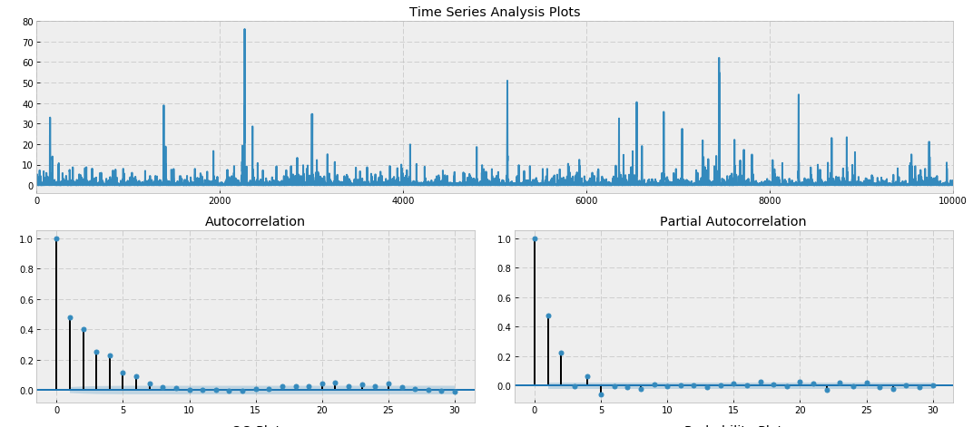
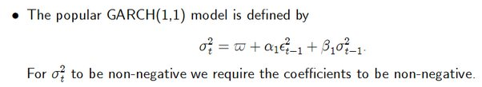
GARCH Modelling Process

Slide 12
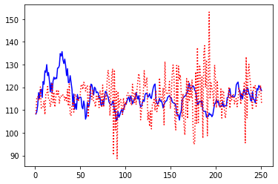
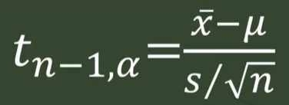
GARCH - T
GARCH student’s T is similar to GARCH Model except, this model allows inference through small samples.
This looks like normal distribution but has fatter tails, which allows higher dispersion of variables since there is more uncertainty in real-time.
Major difference between both models comes from degrees of freedom; Here we have n-1 degrees of freedom because sample standard deviation itself is a random variable which we are calculating.
Formula used:
https://colab.research.google.com/drive/1JuLBF3qgCS0TtyLVSulphWW5atRg6vPW?usp=sharing

